Slide 1



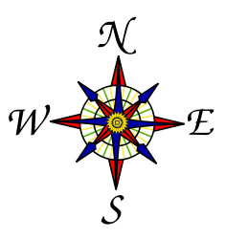

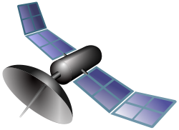
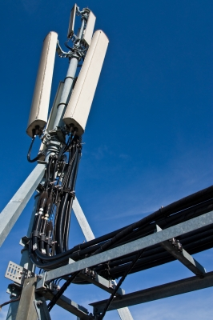
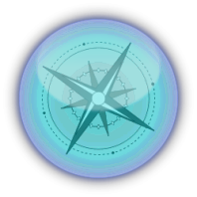
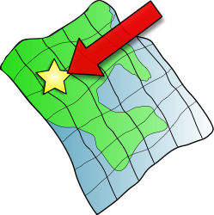
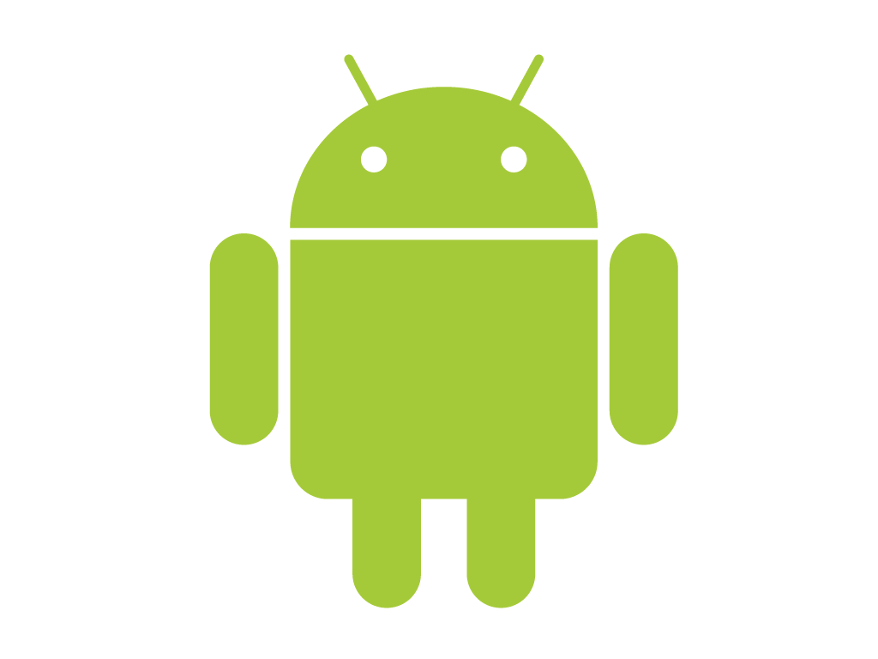
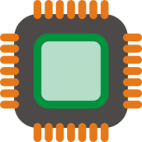

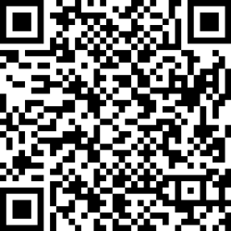
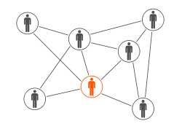
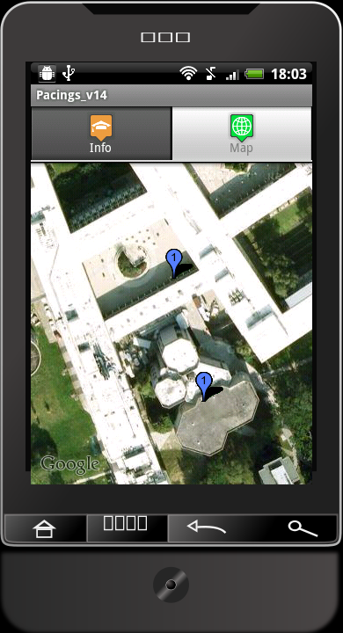

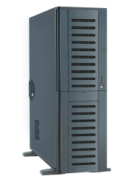


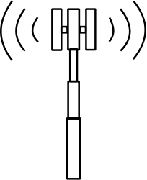


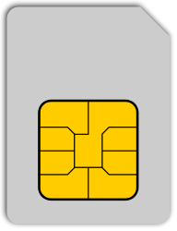

Campus Guide – PDA Android Campus Information Navigation Guidance System
Student: Atanas Kuzmanov Supervisor: Professor Huosheng Hu
Project Goals
This project is about developing a rudimental localisation application which will function in a structured environment. This will be part of a system to help students and visitors have a better experience in the University of Essex, helping them navigate with ease.
Design
The system is developed as an application based on the Android Operating System for an Android PDA (Personal Data Assistent) Smartphone. It has three distinctive levels of navigation functionality:
Level 1: Outer View/GPS based
Level 2: Inner View/Sign based
Level 3: Inside View/Sensor based
Methodology
The system’s development is based on a number of development tools such as Eclipse, Android SDK and SQLite.
Utilizing existing infrastructure such as GPS, Wi-Fi, 3G, CID,
Deploying technologies such as Digital Compass, Accelerometer, QR Codes, and Google APIs.
This product has the potential to be future developed to adopt the following functionalities:
Indoor navigation supported by:
Smartphone’s Digital Compass
Smartphone’s Accelerometer
Smartphone’s QR Code support
Routing algorithm for navigation
Server-side database
Voice streamed navigation
Administrator interface
Guiding disabled people

